Slide 1

KITCHEN
consumption
what are we missing here?

Slide 2

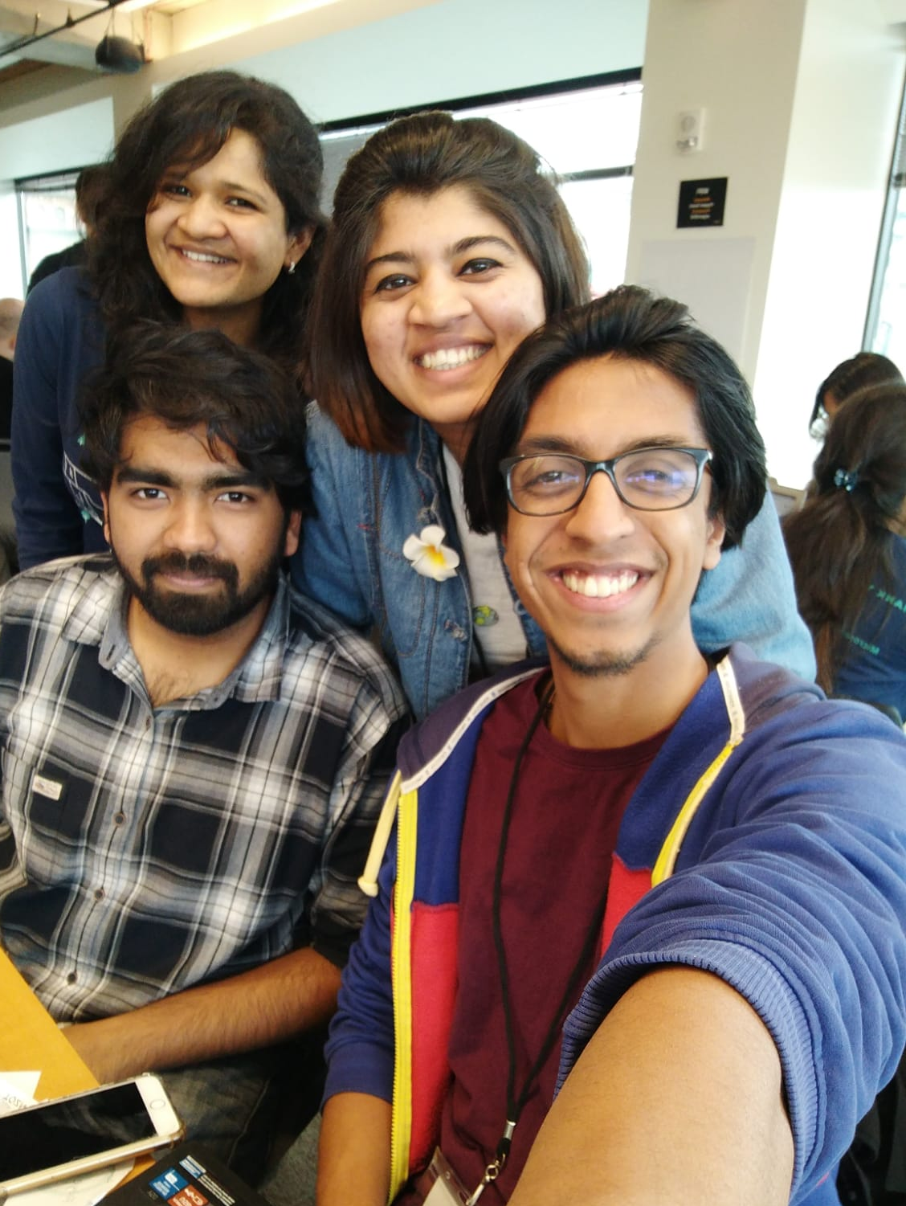

Hello!
We are PMS.
And this is what we came up with.

Slide 3
1
Water

Slide 4

“
“If there is magic on this planet, it is contained in water.”
~Loren Eiselay

Slide 5

900,000,000,000
Gallons used in American households annually

Slide 6

Household
Water consumption
47%
36%
13%
4%
Washing
Bathroom
Kitchen
Other
https://www.epa.gov/watersense/statistics-and-facts

Slide 7


Slide 8


The process
Alert the user by a buzzer and a text message
Check if the tap is on
Check if the tap is unattended

Slide 9



Hardware
PIR motion sensor
Magnetic contact
Buzzer

Slide 10



Slide 11

ON
OFF

Slide 12



Software
!
IFTTT
applet

Slide 13




THE FUTURE

Slide 14



THANKS!

